Slide 1
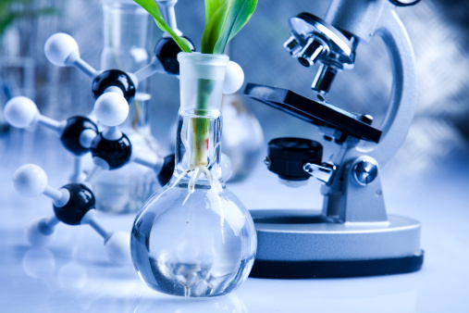
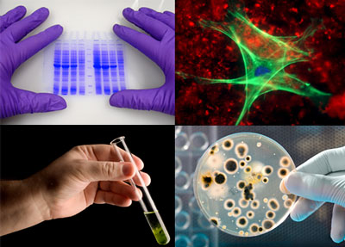
Biotechnology

Slide 2
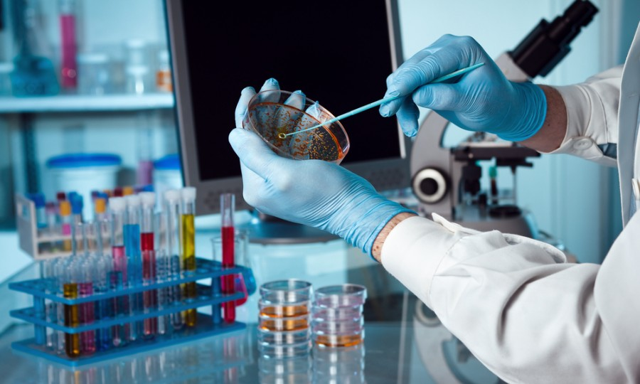
What is Biotechnology?
Biotechnology is the merging of biology and technology to create different products

Slide 3
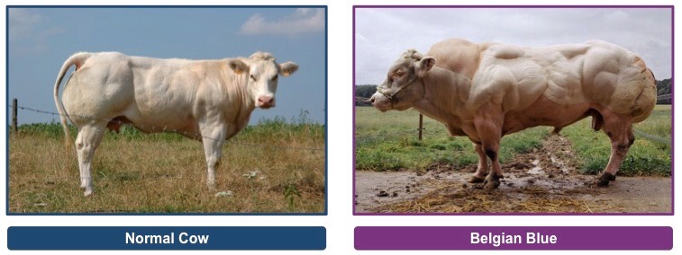
Traditional Biotechnology
Selective Breeding of livestock

Slide 4
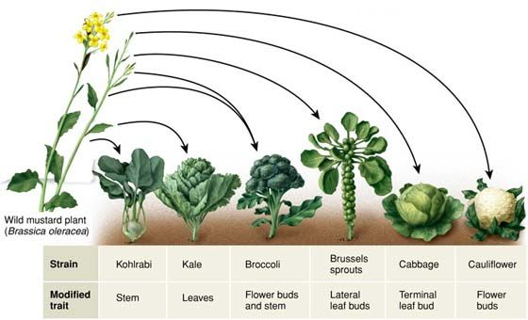
Traditional Biotechnology
Selective Breeding of crops/Hybrids

Slide 5
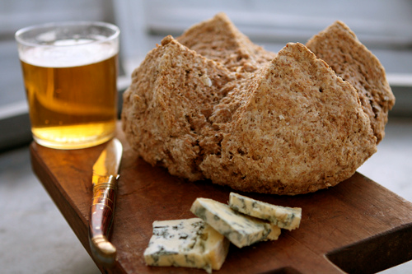
Traditional Biotechnology
Food Production: Beer, Bread & Cheese

Slide 6
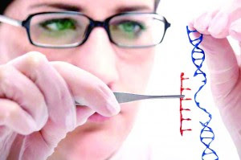
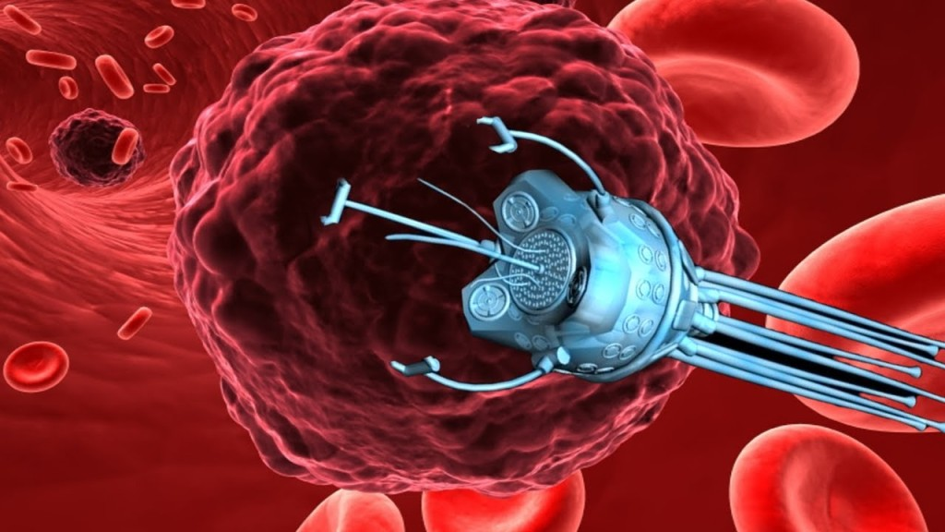
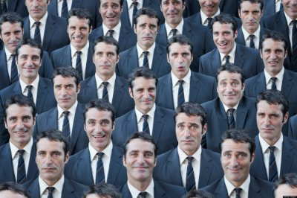
New Biotechnology
Genetic Engineering
& Gene Therapy
Pharmaceuticals
Nanotechnology
Cloning

Slide 7
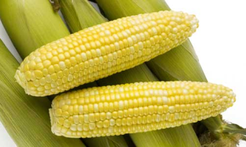
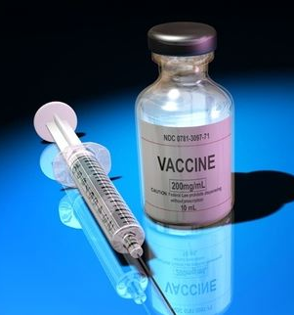
Did You Know?
You use biotech products every day
The biotech industry in involved in environmental issues
Biotech is one of the fastest growing industries in the world

Slide 8
Careers in Biotechnology
$86,950 Biomedical Engineer
$84,940 Biochemist/Biophysicist
$71,730 Agricultural Engineer
$67,790 Microbiologist
$67,420 Epidemiologist
$61,480 Food Scientist and Technologist
$61,110 Animal Scientist
$59,920 Soil and Plant Scientist

Slide 9
YouTube Let’s Make Cheese!

